Slide 1
DIP Final Project
Group 2
鍾毓安、趙序培、溫盛涵
{b01902040, b01902043, b01902099}@ntu.edu.tw

Slide 2
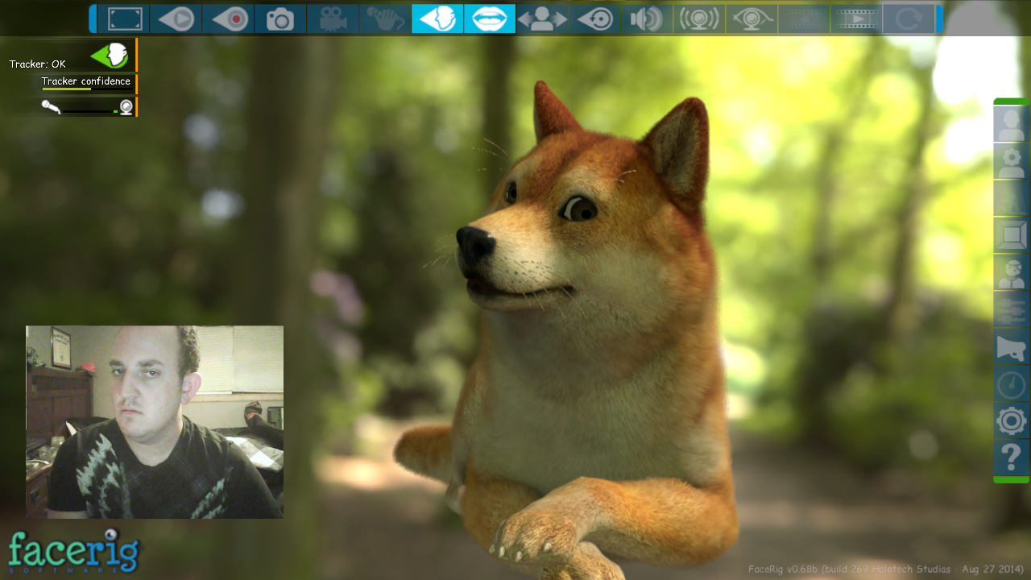
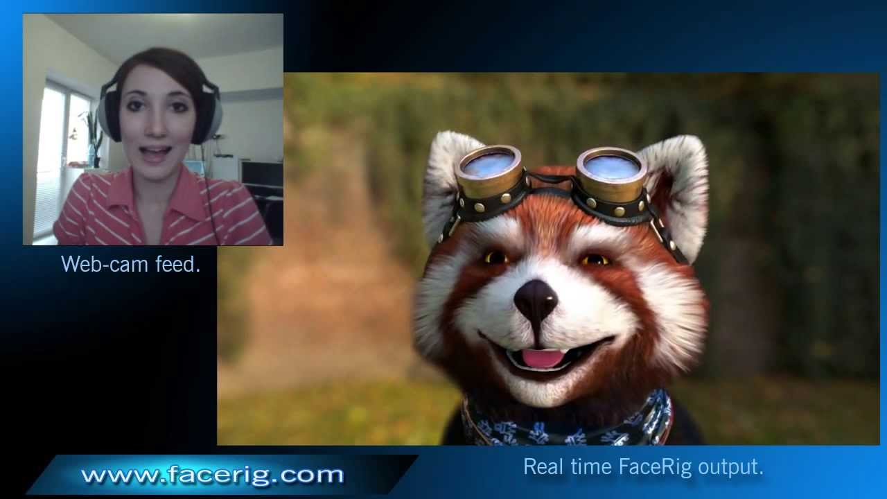
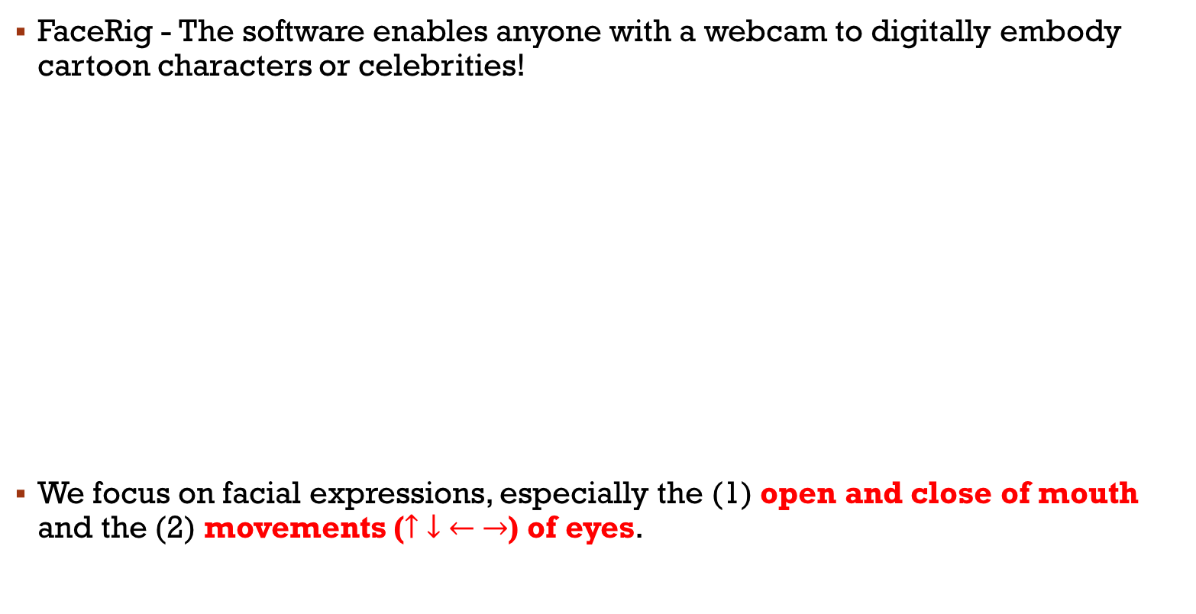
Our Goal
FaceRig - The software enables anyone with a webcam to digitally embody cartoon characters or celebrities!
We focus on facial expressions, especially the (1) open and close of mouth and the (2) movements ($↑ ↓ ← →$) of eyes.

Slide 3
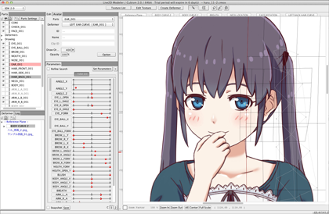
Environments
RealSense、Visual Studio (C++ & OpenCV)
live2D
Unity (C#)

Slide 4
graphs
Visual Studio
Face detection
Eyes location detection
Mouth location detection
Decide the movements of eyes and mouth and pass the control parameters
Unity
Load the live2D model
Call CameraViewer.exe to retrieve the control parameters
Pass the control parameters via the live2D API
Compile
Call
RealSense Camera
CameraViewer.exe
Return the control parameters
Image Capture
Call the live2D API
The 2D character will then do the same facial expression like us!
live2D

Slide 5
Demo
https://www.csie.ntu.edu.tw/~b01902040/doc/DIP_final_demo.mp4

Slide 6
We are Group 2
Thanks for your attention! Hope you enjoy our work!
Future work (before the deadline of final package):
1. More accurate!
2. More facial expressions (e.g. eyebrows, head)!

